Slide 1



CORE CONCEPTS
Part1
25 August 2019

Slide 2
AGENDA
Intro to Angular
Angular CLI
What is Typescript
Components
Component Interactions
Modules
Routing

Slide 3


What is Angular?
Angular is a TypeScript-based JavaScript framework backed by Google.

Slide 4
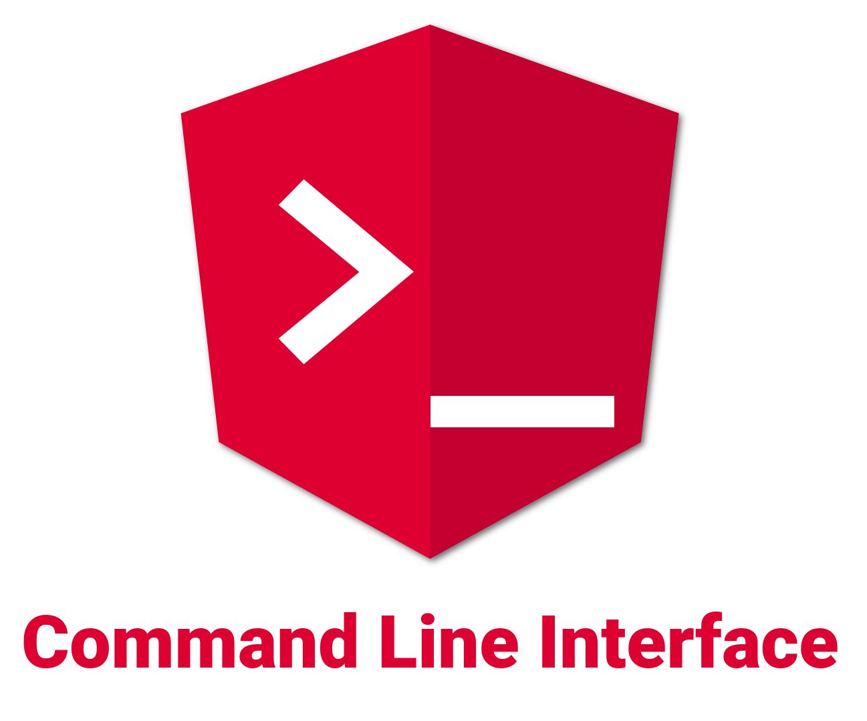
Angular CLI
Basic commands:
> npm install -g @angular/cli
> ng new [name]
> ng serve
> ng generate component [name]
> ng generate module [name]
https://cli.angular.io/

Slide 5

What is Typescript?
TypeScript is a typed superset of JavaScript that compiles to plain JavaScript.

Slide 6
Typescript basics
Regular JS:
function fn(input) {
return input.trim().length
}
let res = fn(' 123 ');
console.log(res); //3

Slide 7
Typescript basics
With types:
Something wrong:
function fn(input: string): number {
return input.trim().length
}
let res = fn(' 123 ');
console.log(res); //3
function fn(input: string): number {
return input.trim().length
}
let res = fn(123);
console.log(res); //error
Argument of type 'number' is not assignable
to parameter of type 'string'.

Slide 8
Typescript basics
interface IArticle {
id: number;
heading: string;
author: Author;
creationDate: string;
description: string;
tags?: string[];
}
export class Article implements IArticle {
id: number;
heading: string;
author: Author;
creationDate: string;
description: string;
tags: string[];
constructor(formData: IArticle) {
this.id = formData.id;
this.heading = formData.heading;
this.author = formData.author;
this.creationDate = formData.creationDate;
this.description = formData.description;
}
}

Slide 9
Angular CLI
Basic commands:
> npm install -g @angular/cli
> ng new [name]
> ng serve
> ng generate component [name]
> ng generate module [name]
https://cli.angular.io/

Slide 10
Basic Angular ‘building blocks’
Services
Modules
Components
Directives
Routing
Etc..

Slide 11
Modules
cli command: ng generate module[name]
@NgModule({
declarations: [
AppComponent
],
imports: [
BrowserModule
],
providers: [],
bootstrap: [AppComponent]
})
export class AppModule { }

Slide 12
Components
Every block can be a component; You can reuse and modify them as you like.

Slide 13
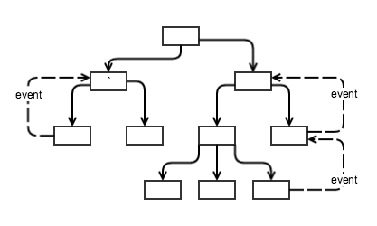
Components
Hierarchy:

Slide 14
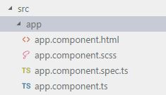
Components
cli command: ng generate component [name]
@Component({
selector: 'app-root',
templateUrl: './app.component.html',
styleUrls: ['./app.component.scss']
})
export class AppComponent implements OnInit {
public title: string;
public ngOnInit(): void {
this.title = 'Check the news!';
}
}

Slide 15
Components (template)
<div class="app-page" [ngClass]="{'active': isActive“} >
<h1>
Hi there, {{ title }}!
<ng-container *ngIf="checkSource()">
(only trusted source)
</ng-container>
</h1>
</div>
<div *ngFor="let item from news; let i = index;">
<single-source-item
[content]="item?.content" (click)="checkItem(i)"></single-source-item>
</div>

Slide 16
Components (styles)
.app-page {
display: block;
padding: 6px 12px;
text-decoration: none;
&.active {
font-weight: bold;
}
}
single-source-item {
display: block;
}
:host {
display: block;
border: 1px solid black;
}

Slide 17
Components (properties)
To create any property, declare it and it’s type (the same as in ES6 class). You can also set an initial value:
public name: string = 'John';
Access it with ‘this’ keyword in methods…
changeName(): void {
this.name = 'Jack';
}
… but no need to use ‘this’ keyword in templates, just work with name:
<h1>My name is {{name}}</h1>
You can perform some operations inside curly braces:
<h1>My name is {{name[0] === 'J' ? name : 'not specified'}}</h1>
Do not mix curly brackets with square ones in a single expression. If working with any attribute in squares, pass the name of the property only :
<img [src]="pathToImage" />

Slide 18

Components (structural directives)
To conditionally display something, use *ngIf directive
<span *ngIf="isActive">[active unit]</span>
To display an array of data in a template (e.g lists), use *ngFor:
public personList: Client[] = [
{name: 'John', client: 'Microsoft'},
{name: 'Larry', client: 'Apple'},
{name: 'Laura', client: 'Oracle'}
]
<ul>
<li *ngFor="let person of personList”>{{person.name}} ({{person.client}})</li>
</ul>

Slide 19
Components (methods)
The methods are the same as in ES6, just with TS types:
getAvailability(item: DataItem): boolean {
return !!(item.slots && item.slots.length)
}
The usage of methods in templates is often for condition...
<span *ngIf="getAvailability(item)">Time Available</span>
…or for user event handling:
setAvailability(id: number): boolean {
this.slotService.book(id, this.date);
}
<div (click)="setAvailability(slot)">Allow time</div>

Slide 20
Component interactions
From Parent to Child:
@Input()
In parent component template, child component provided with data:
<child-item [name]="'Bob'" [additionalData]="someInfo"></child-item>
In child component, use @Input decorator to ‘take’ incoming properties:
export class ChildItemComponent implements OnInit {
@Input() name: string;
@Input() additionalData: { address: string, age: number};
}
In child component template, use @Input values as usual properties:
<ul>
<li><b>Name: </b>{{name}}</li>
<li><b>Age: </b>{{additionalData.age}}</li>
<li><b>Address: </b>{{additionalData.address}}</li>
</ul>

Slide 21
Component interactions
From Child to Parent:
@Output()
In child component, use @Output decorator to declare a property to pop to the parent:
@Output() smthToOutput: EventEmitter<string> = new EventEmitter();
Then make a handler that will trigger the emitter.You may and pass some data to it:
public selectAttribute(data: string):void {
this.smthToOutput.emit(data);
}
<li (click)="selectAttribute(name)">
{{name}}
</li>
In the parent component template , create a listener (with the same name as @Output you want to listen) on child’s component selector. Pass reserved name ‘$event’ to use data from Event:
<child-item (smthToOutput)="hadleEvent($event);"></child-item>
Create a handler, that will fire whenever the @Output event triggers. Use a data from event if needed:
hadleEvent(event: string){
this.name = event;
}

Slide 22
Routing
In an app.module.ts (in our case), add array of routes of type ‘Routes’:
const AppRoutes: Routes = [
{path: '', component: ParentComponent},
{path: 'child', component: ChildItemComponent},
{path: 'server/:id', component: MachineComponent}
];
Then in @NgModule, in the import our array of routes. Important: it’s imported by passing array name as an argument to a RouterModule method, not as array:
imports: [
RouterModule.forRoot(AppRoutes),
BrowserModule,
...
],
Then add a special routing selector router-outlet in the template, which will contain all routing changes. In our case, it’s in the app.component.html. After that, all router components from AppRoutes will be rendered in the router-outlet as in container:
<div>
<h1>
Welcome to {{ title }}!
</h1>
<router-outlet></router-outlet>
</div>

Slide 23
Routing (dynamic)
In a component that will be loaded be the route, pass ActivaredRoute property in constructor:
constructor(private route: ActivatedRoute) { }
Then you can access the property of a route, in our case server/:id, and use it as needed.
this.route.snapshot.params['id']
Alternatively, you can subscribe to route change, but for first HW it is hardly needed.
this.route.params.subscribe((params: Params)=>{
this.id = params['id'];
})

Slide 24
Thank you!

